Slide 1

Information System Design & Software Engineering Lab Cse 3036 Section 12
Railway Management System
Submitted By:
Group Name: Overwatch
Arpon Goswami 2015200000072
Faria Lara 2015000000204
Md. Redwan Asif 2015200000081
(Section: 11)

Slide 2
Introduction
Railway management system is a system which will help in making railway services more desirable than it is now. Currently railway services are thought of as very bad. With the implementation of the railway management system, hopefully the usage and satisfaction level will increase. We will even be able to further improve the system according to the reviews collected via the system.

Slide 3
Objective
Day to day life requires constant traveling from one place to another. Even though this traveling can be made easy via the use of railway services, many people choose to follow other means due to railway services not being as desirable. Even the people that does travel using the railway services, are not satisfied with the services provided. The objective of this project is to maximize public desire to use railway services and to make sure that the provided service leaves everyone satisfied. Also, to provide a platform where people can make suggestions or complaints which will help the services get better with time.

Slide 4
Use Case Diagram...

Slide 5
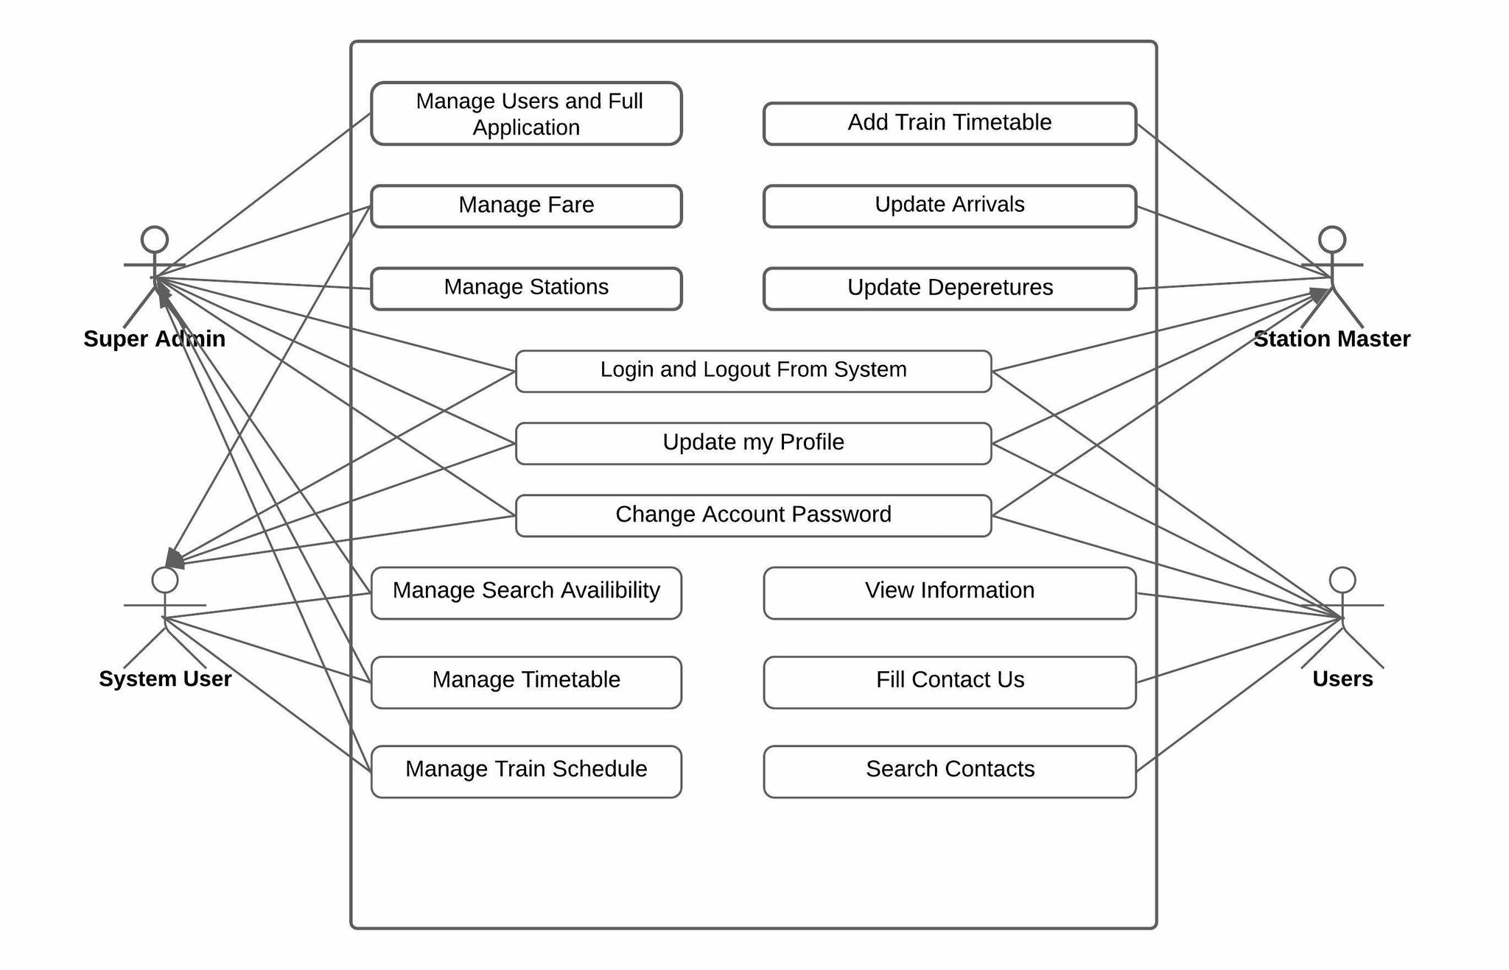

Slide 6
Activity Diagram...

Slide 7
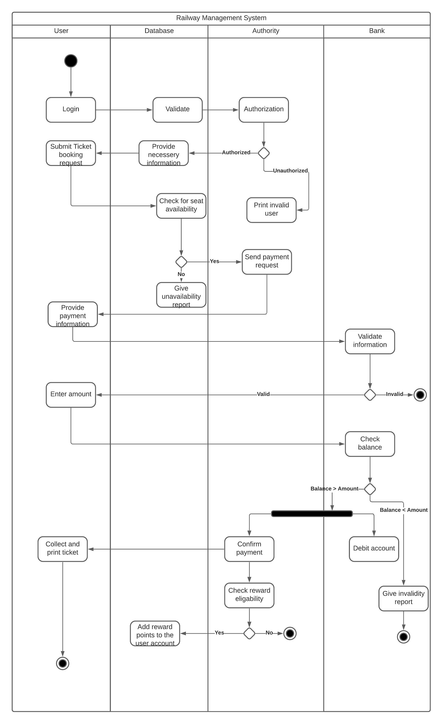

Slide 8
Entity Relationship Diagram...

Slide 9
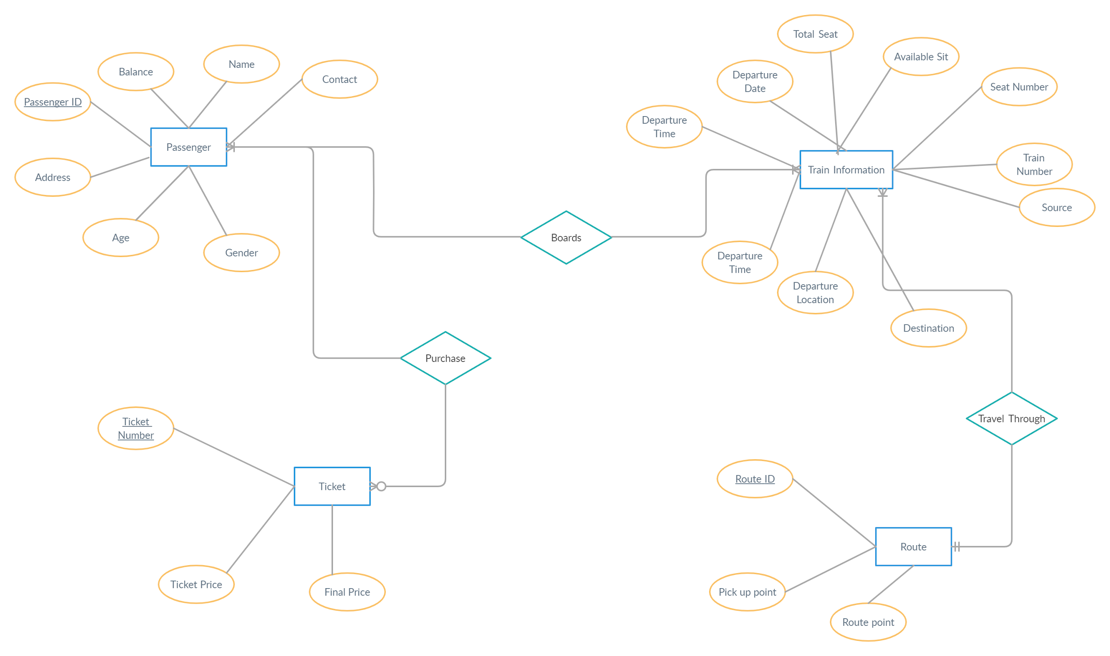

Slide 10
Data Flow Diagram...

Slide 11
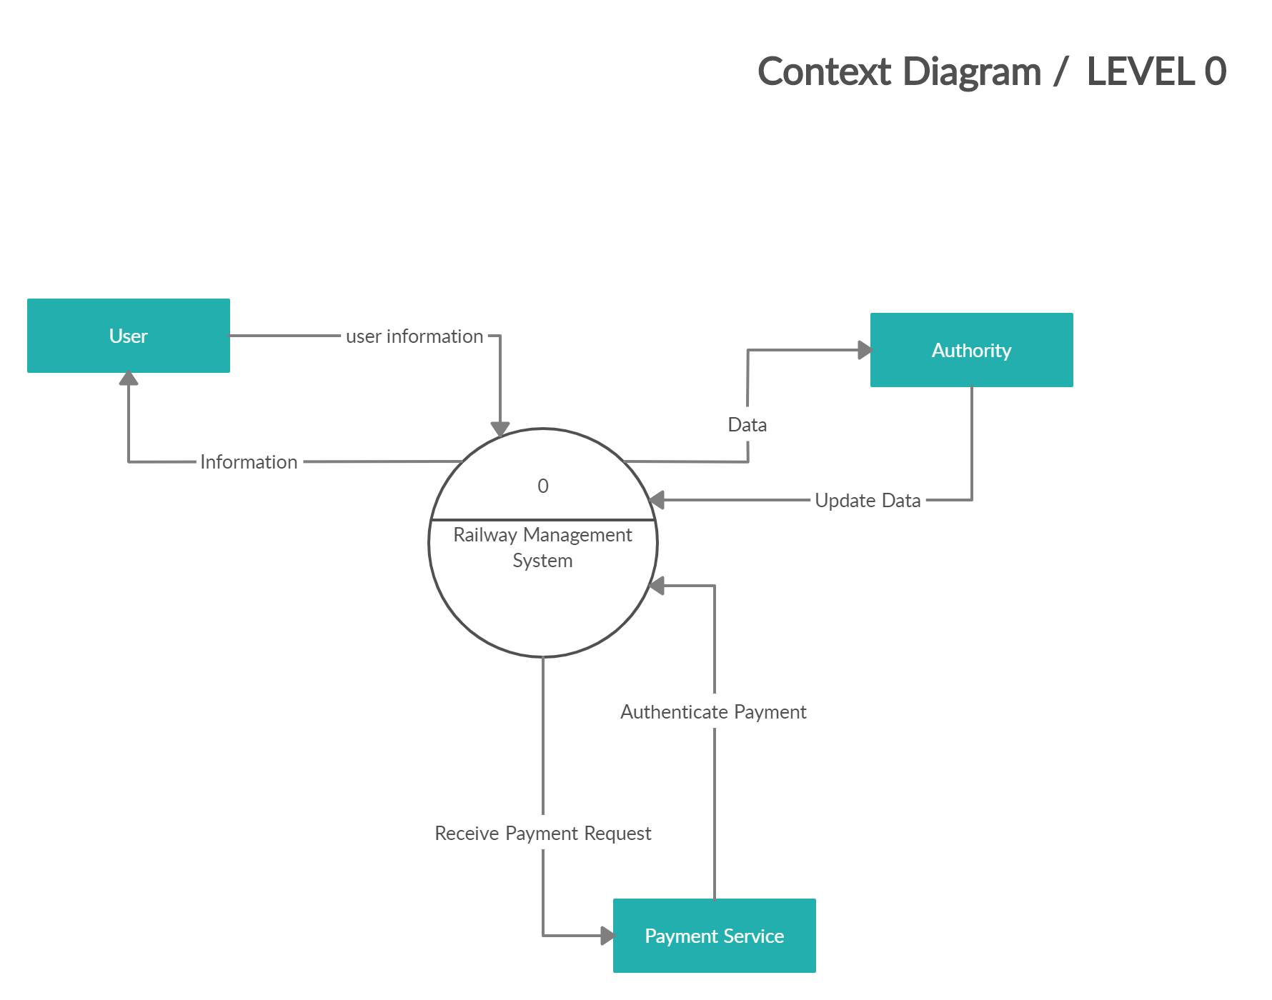

Slide 12
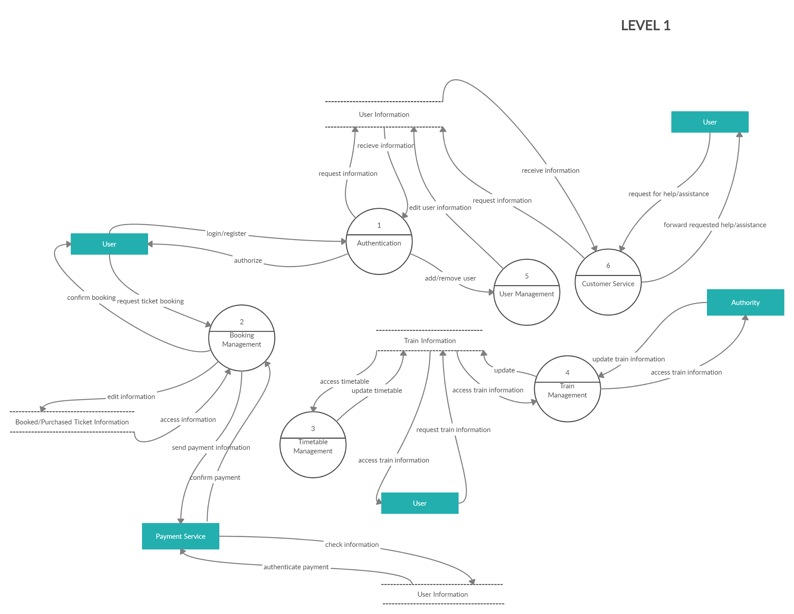

Slide 13
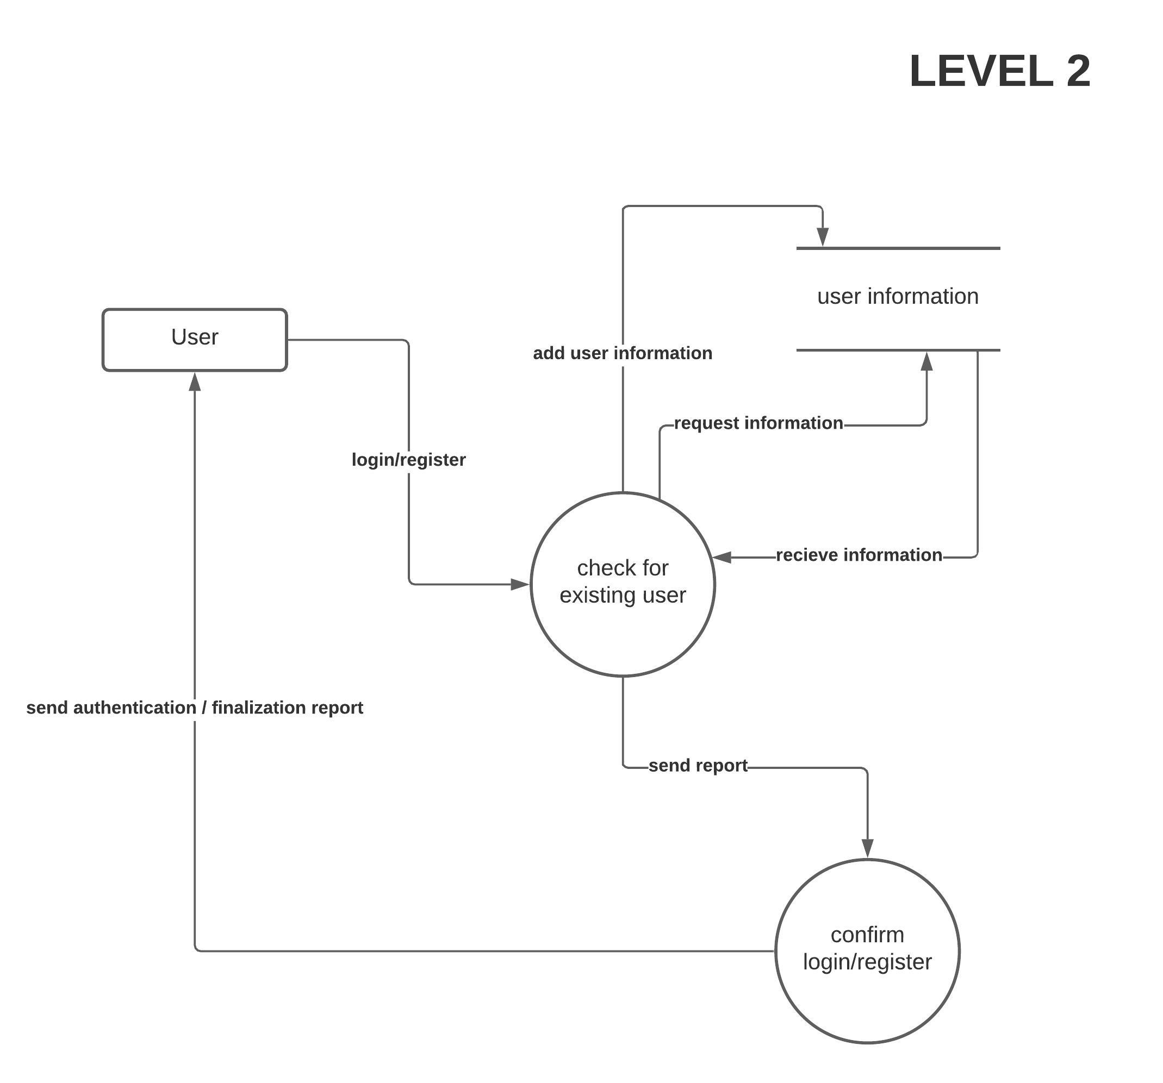
Authenticate...

Slide 14
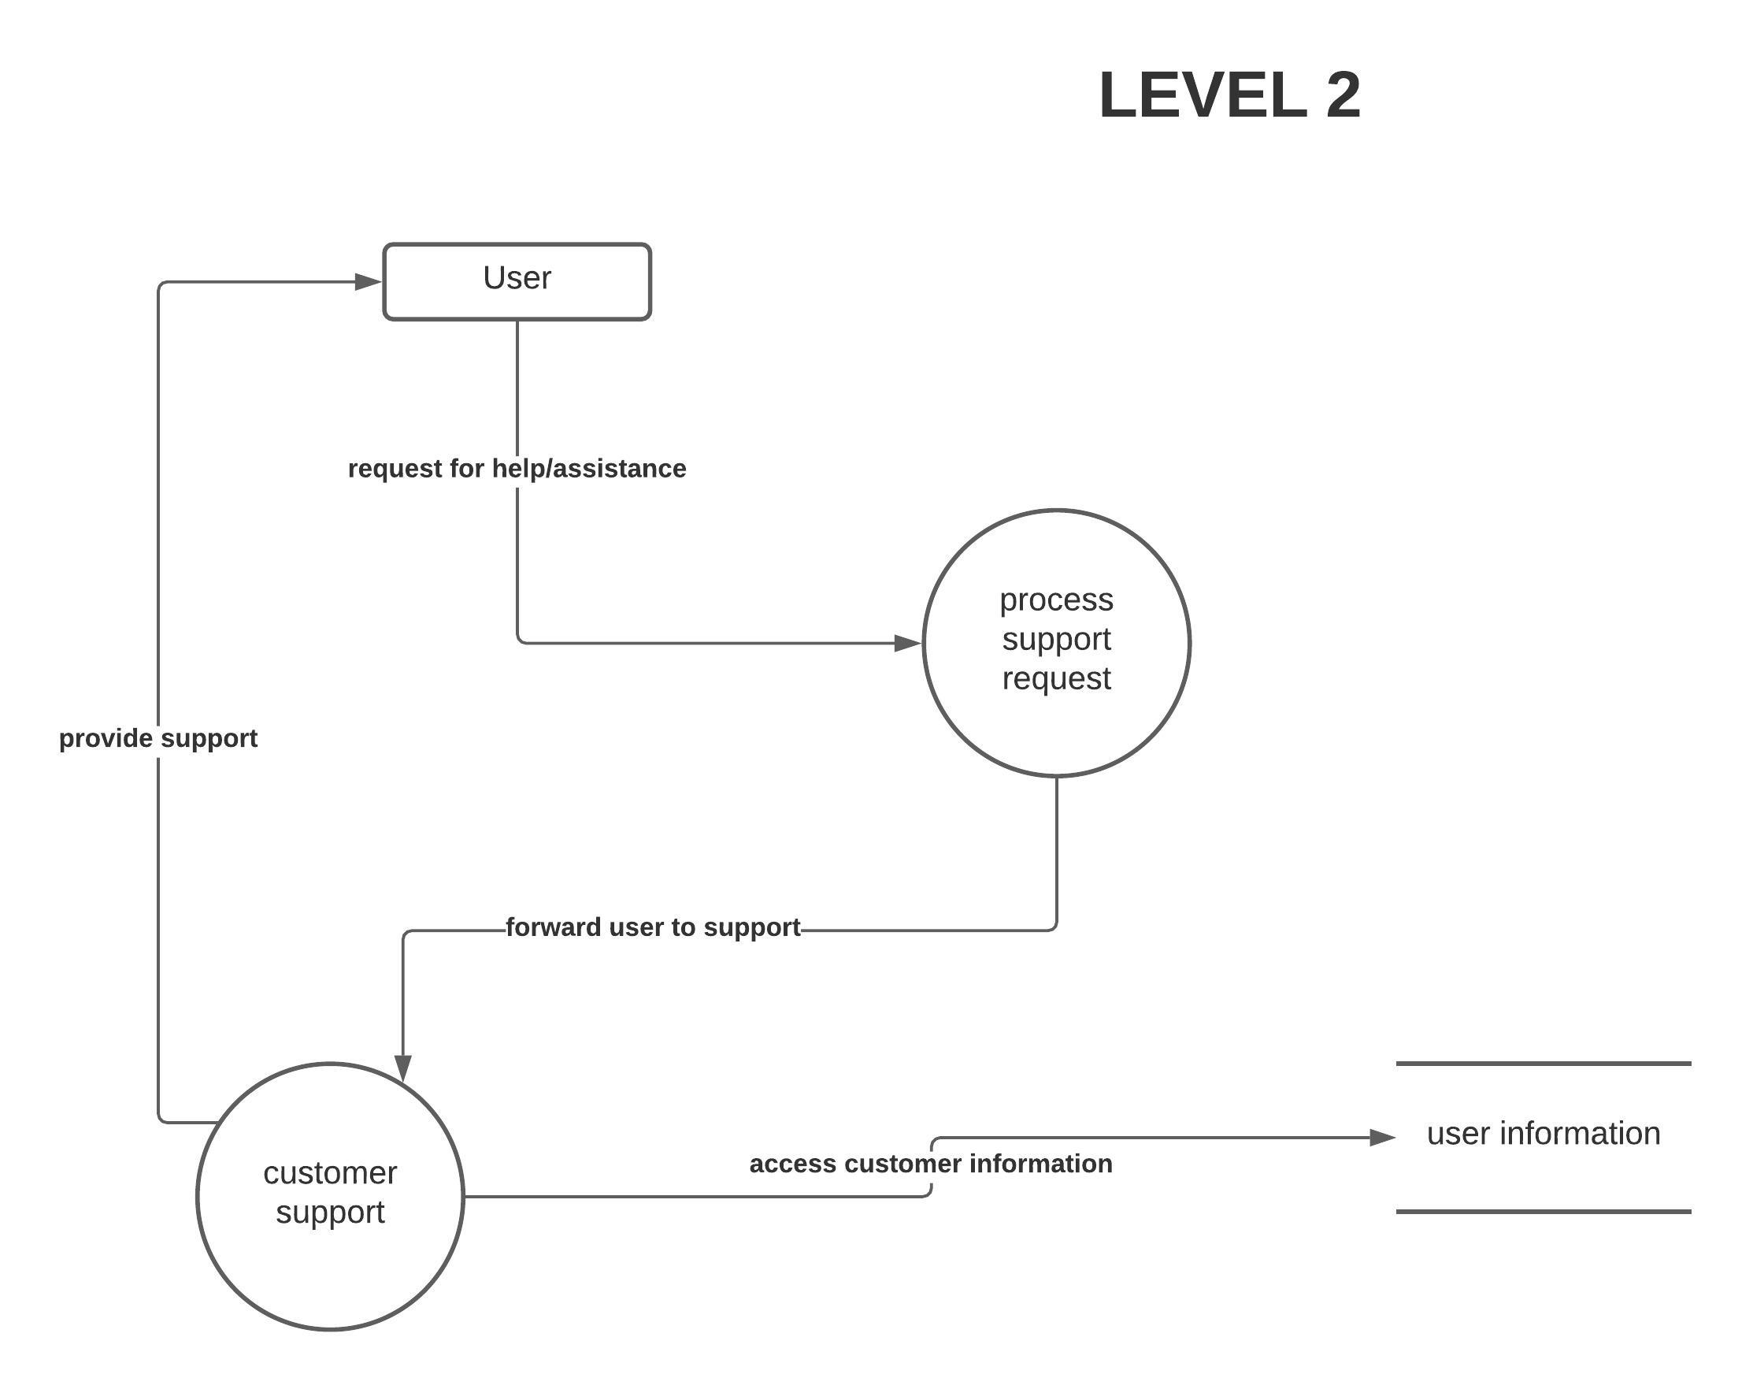
Customer Service...

Slide 15
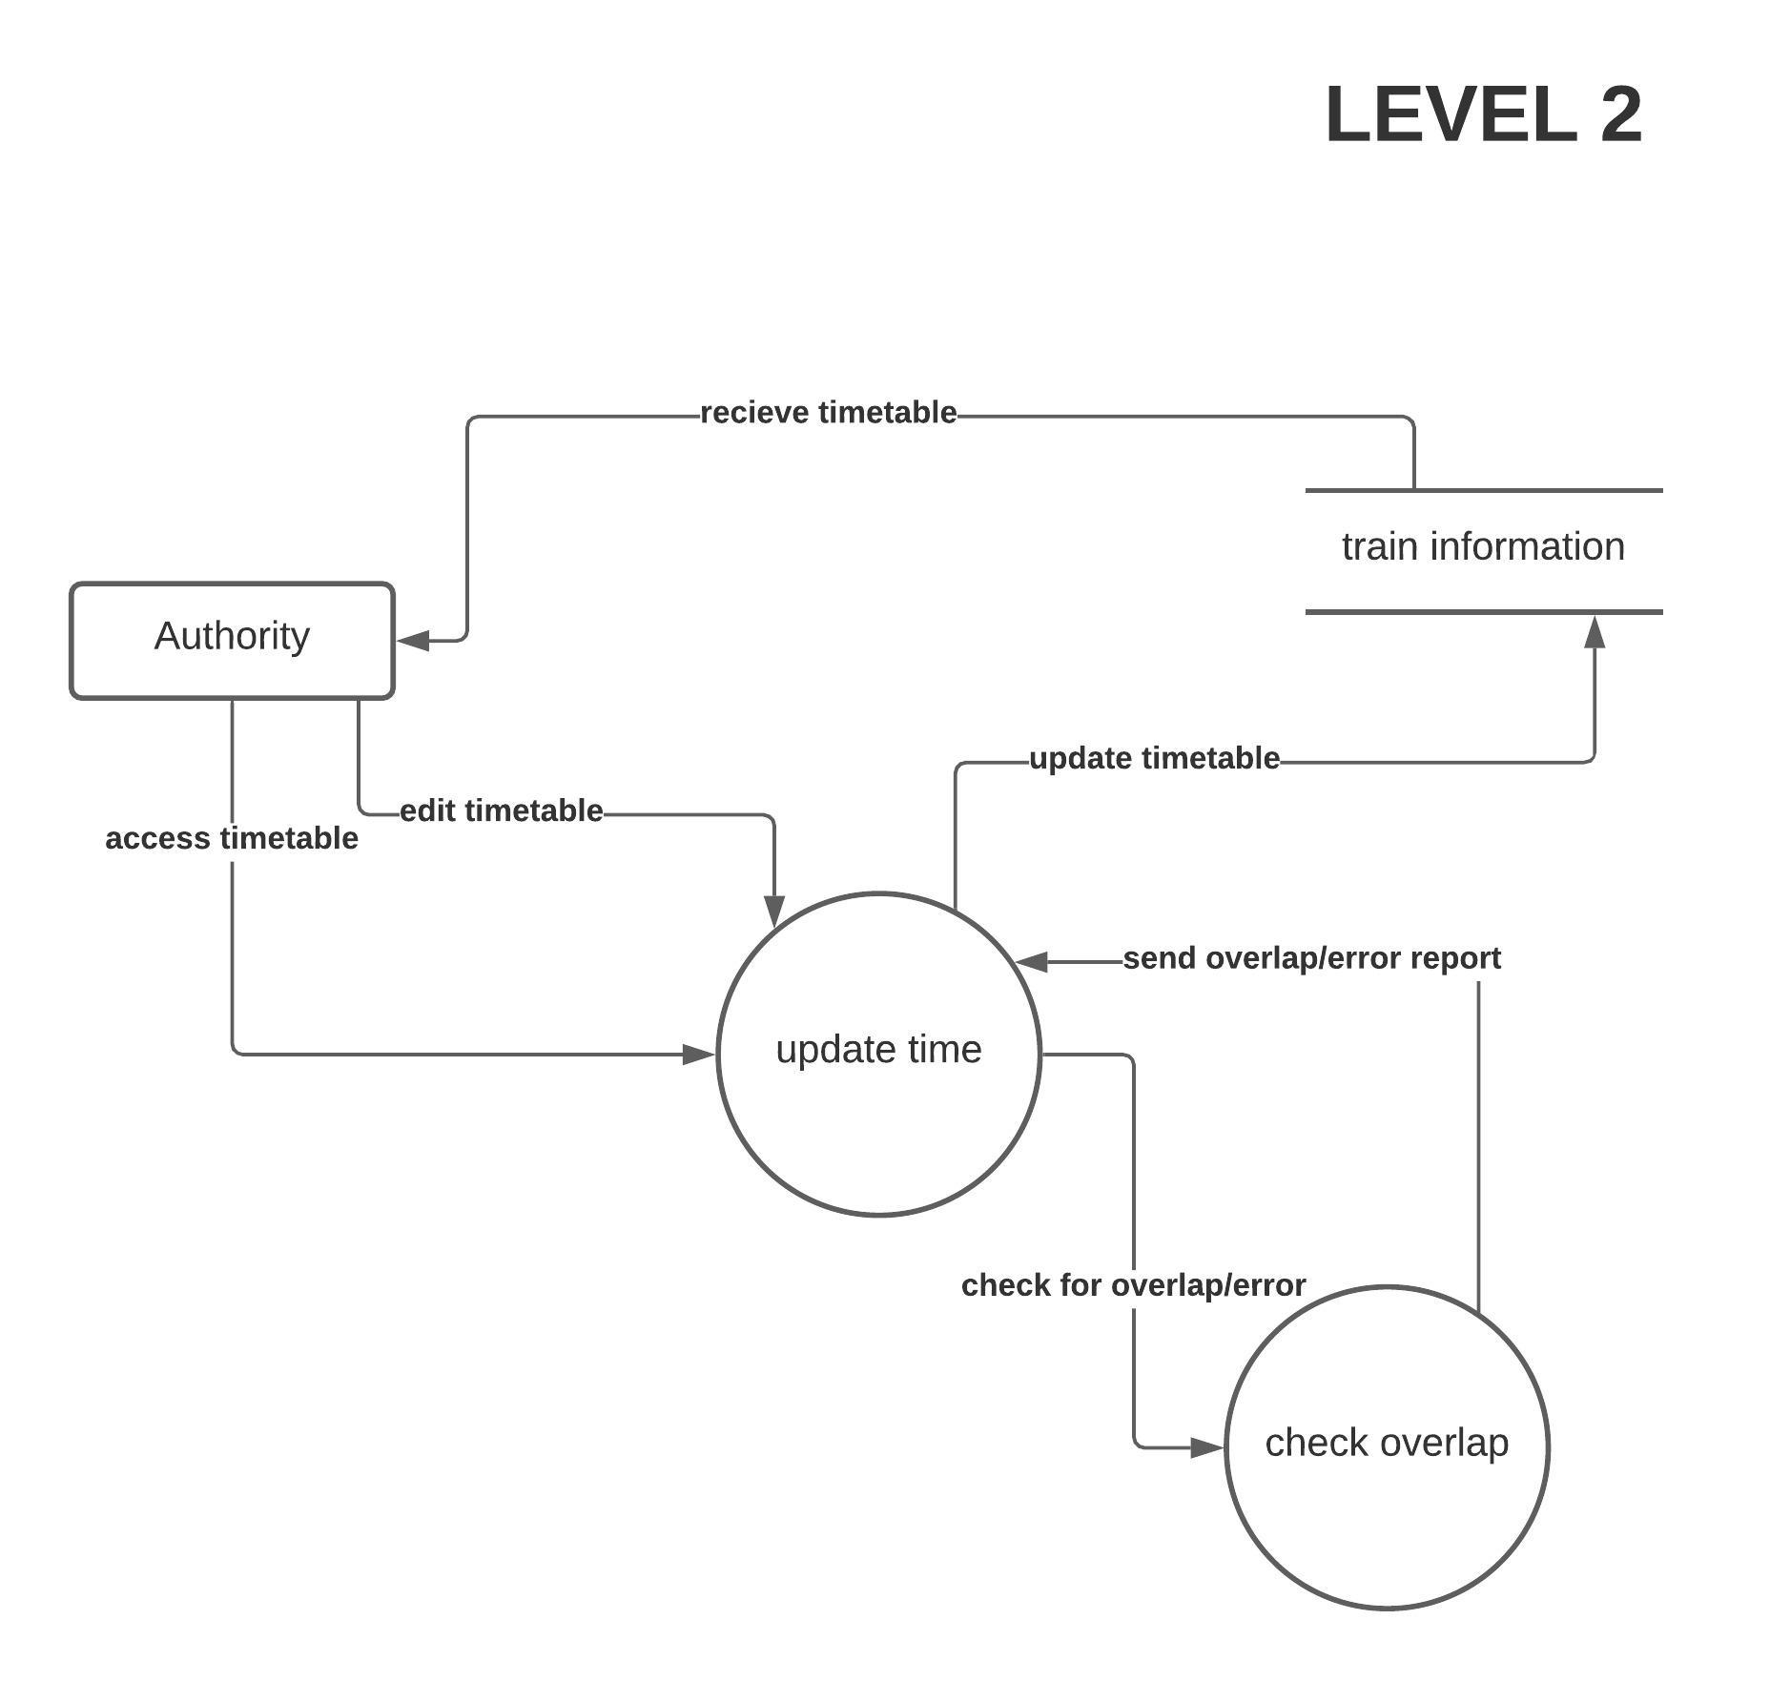
Timetable Management...

Slide 16
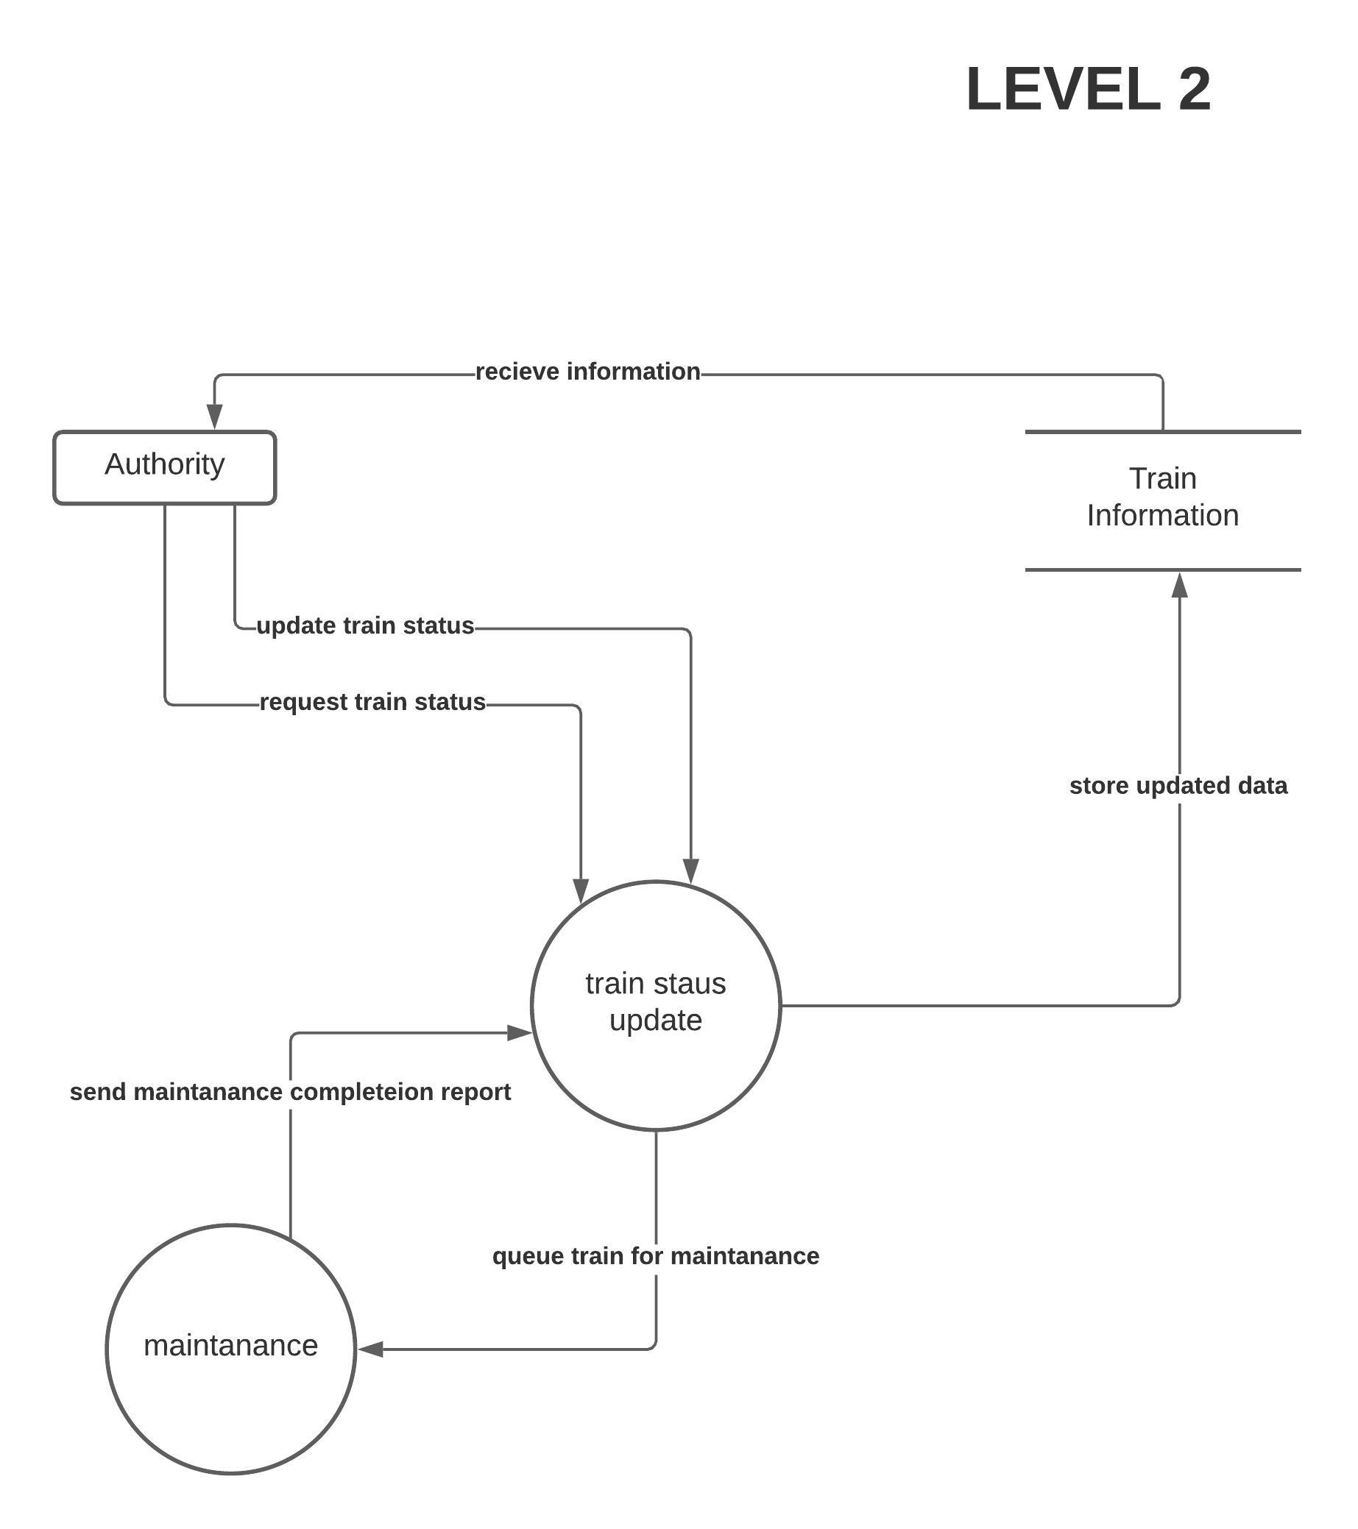
Train Management...

Slide 17
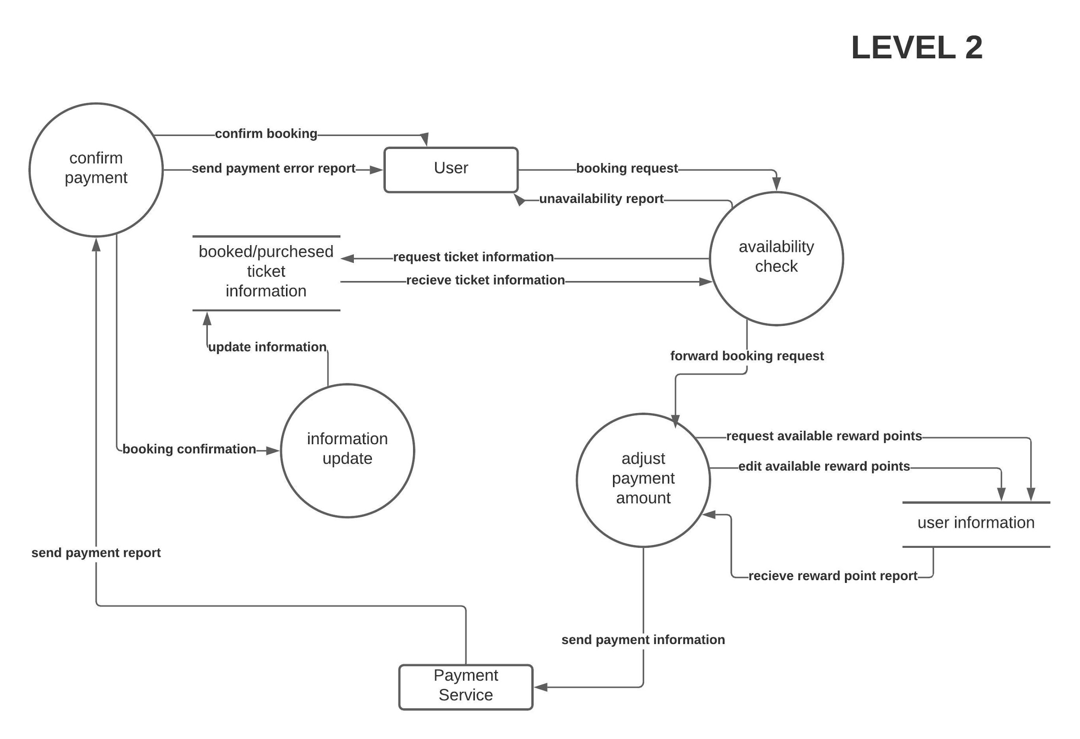
Booking Management...

Slide 18
Requirements
The database system must be secured.
There has to be a feedback section where people will be able to share their valuable opinions and suggestions.
Must be easy to use and comprehend.
Employees must be well trained for new change. Or new and more capable employees have to replace the others.

Slide 19
Constraints
Minimize the cost as much as possible while making sure the outcome remains good.
New upgrades must be done in a way where services can still be provided while the upgrade is ongoing.

Slide 20
Thank You

